Slide 1
About this course
The ECP is correct (until its not)
Wednesdays at 5pm: lectures on experimental design (John Dwyer)
Before Thursday: watch a pre-recorded lecture on statistics (John Dwyer)
Thursdays at 1pm: Workshop on material covered in pre-recorded stats lecture (but not in first week – it will be a lecture)
Thursdays at 5pm: lectures on conservation science (Rich Fuller)
Fridays at 9am: R prac (John Dwyer, Ella Cathcart-van Weeren)

Slide 2
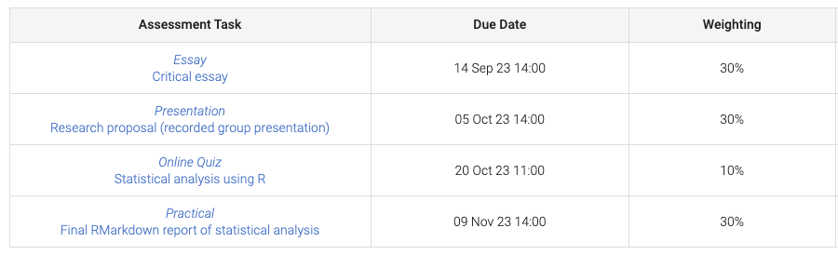
Assessment
GROUP
WEEKLY
Weekly Quiz (ten total): Each quiz has six multiple choice questions to be completed after the prac (before midday on the following Monday)
A mark of 4/6 or higher gets you 1 mark (10 marks across the semester)

Slide 3
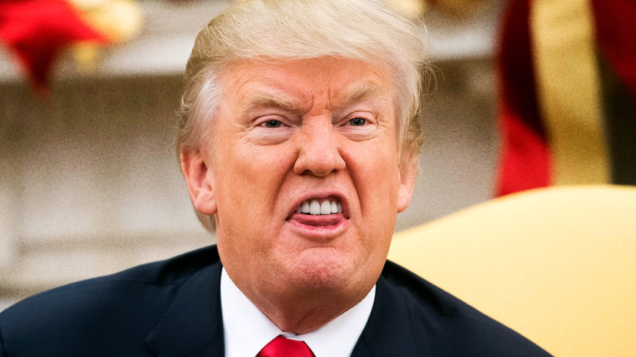
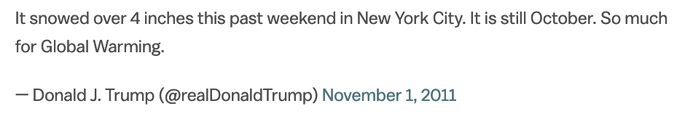
Introduction to the scientific method
Dr John Dwyer CONS7008

Slide 4
Is this evidence?
“I’ve noticed over the last 2 decades that trees grow better when it’s a full moon” (Experienced restoration practitioner)
“Dingoes are good for the conservation of all native mammal species in Australia” (University Professor in chemistry)

Slide 5
Is this evidence?
“I’ve noticed over the last 2 decades that trees grow better when it’s a full moon” (Experienced restoration practitioner)
“Dingoes are good for the conservation of all native mammal species in Australia” (University Professor in chemistry)
Anecdotal at best!
Evidence collected in a casual or informal manner and relying heavily or entirely on personal testimony

Slide 6
So what is evidence?

Slide 7
So what is evidence?
Information collected to support or refute a theory or hypothesis
‘Strength’ of evidence is generally based on the statistical analysis of experimental or observational data

Slide 8
But nature in ‘messy’
How do we gather evidence in DYNAMIC and COMPLEX systems?

Slide 9
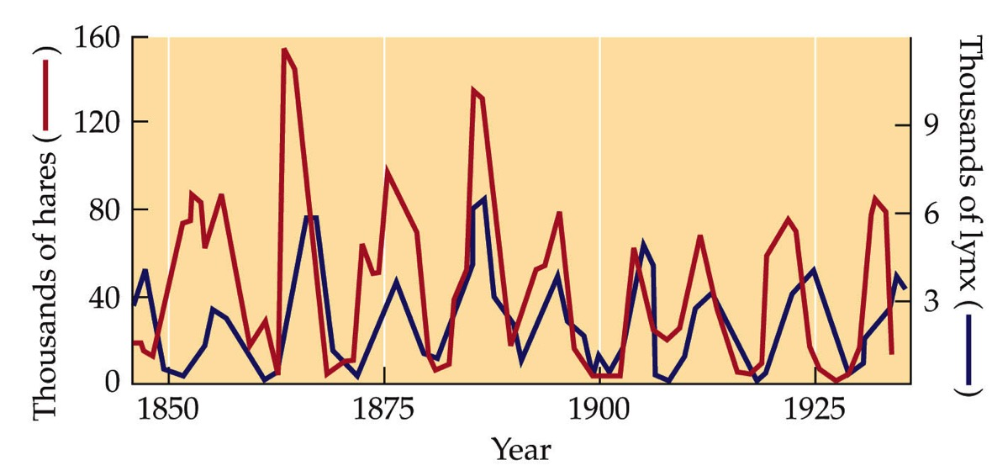

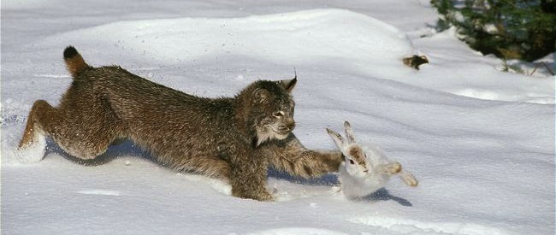
Temporal dynamics (changes through time)

Slide 10
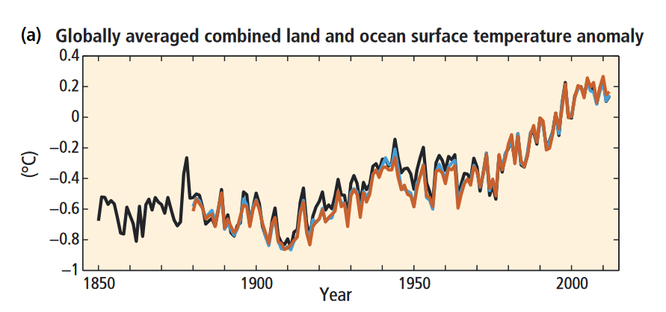
Temporal dynamics (changes through time)
IPCC 2014 Summary for Policymakers

Slide 11
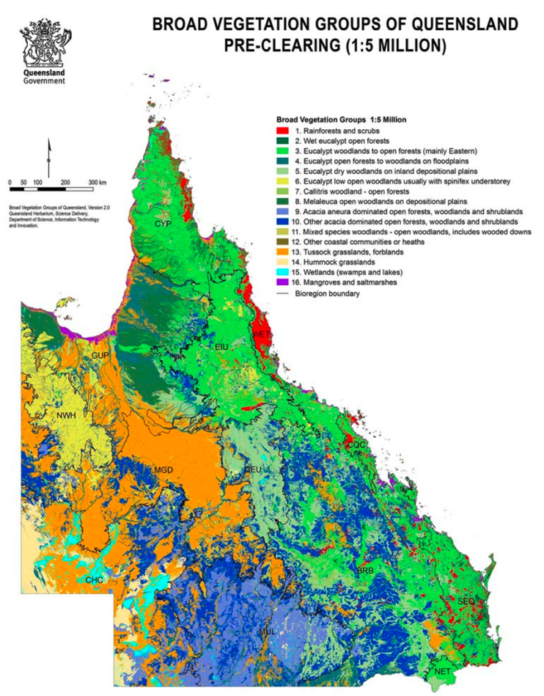
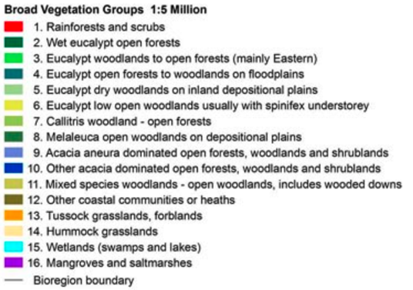
Spatial dynamics (changes through space)

Slide 12
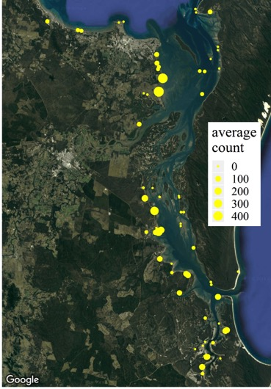
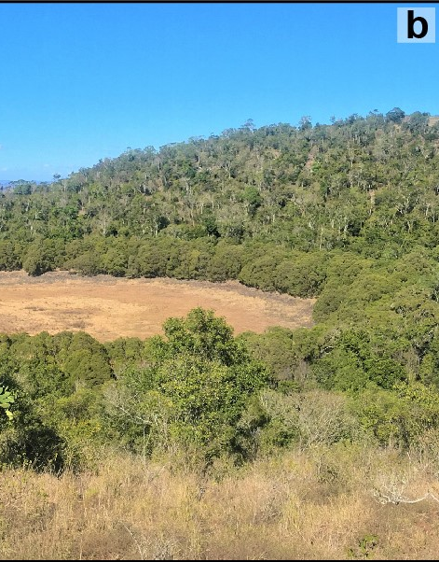
Spatial dynamics (changes through space)
http://britgeopeople.blogspot.com/2018/10/getting-taste-for-australian-drought.html

Slide 13
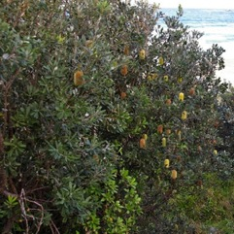
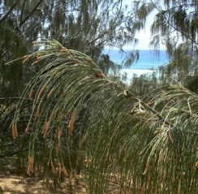
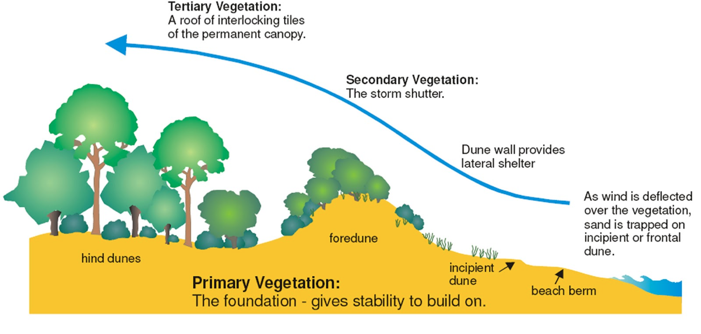
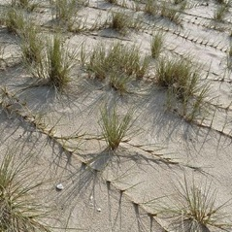
Spatio-temporal dynamics
http://blog.ltc.mq.edu.au/torihale/2015/03/17/restoring-coastal-sand-dunes/

Slide 14
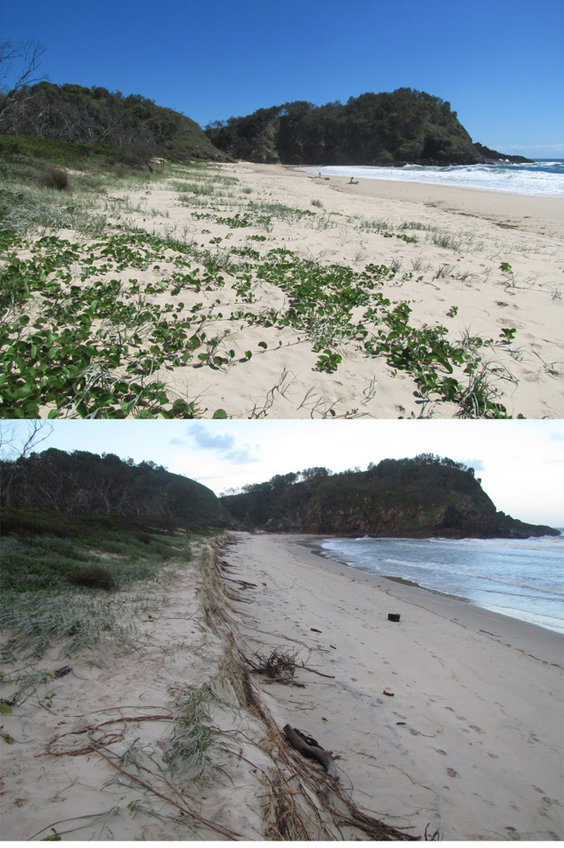
Spatio-temporal dynamics
http://grassyheadvolunteernursery.blogspot.com.au/p/blog-page_11.html

Slide 15
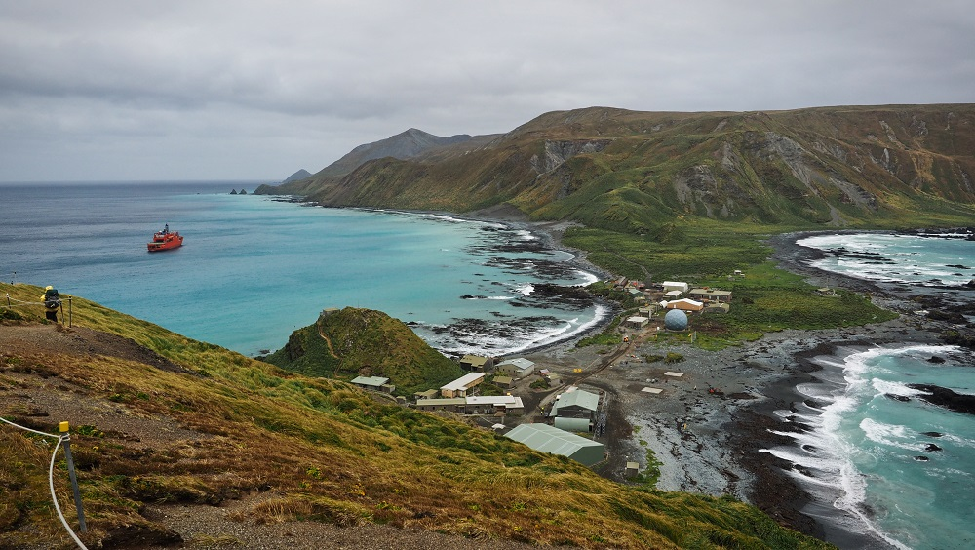
Nature in also COMPLEX

Slide 16
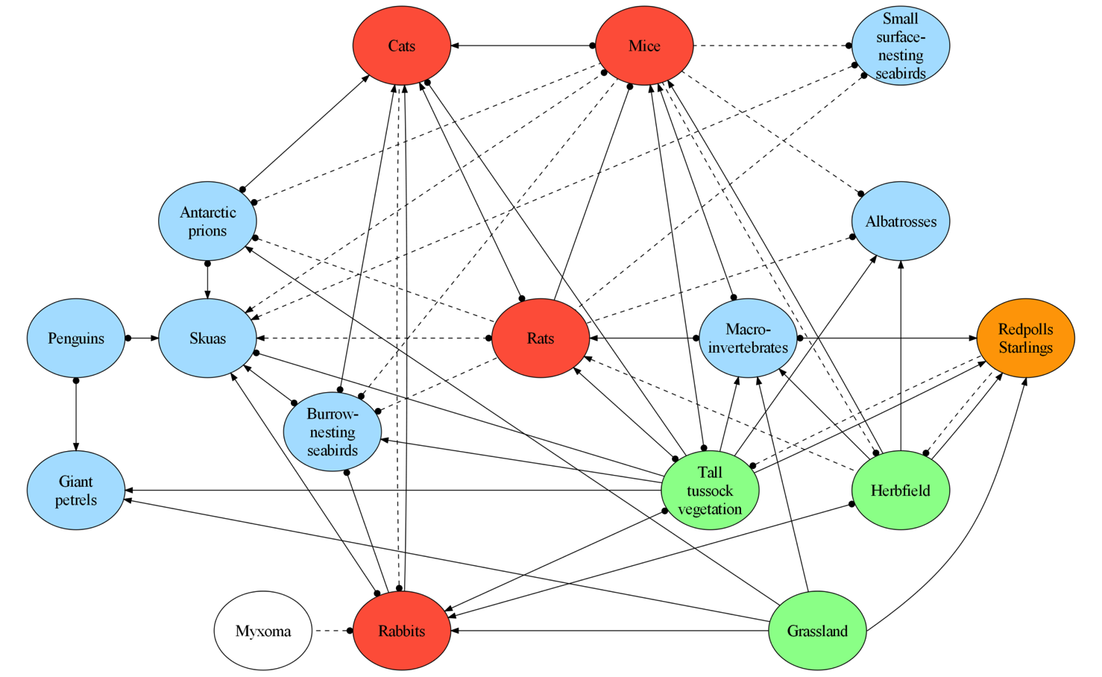
Nature in also COMPLEX
Raymond et al 2011. J. Applied Ecology

Slide 17
And…
We can’t be everywhere all the time to measure all of this!!!
SO OUR KNOWLEDGE IS ALWAYS INCOMPLETE!!!

Slide 18
Dynamics +
Complexity +
Incomplete knowledge
UNCERTAINTY IN OUTCOMES

Slide 19
Should we even bother?

Slide 20
Yes!!!
But we need to be intelligent and rigorous about it

Slide 21
The scientific method
Research Question
Develop hypothesis(es) and predictions
Design and execute study to evaluate support for hypothesis(es)
Draw conclusions based on evidence

Slide 22
The scientific method
Often developed from keen observations or previous studies
Research Question
Develop hypothesis(es) and predictions
Design and execute study to evaluate support for hypothesis(es)
Draw conclusions based on evidence

Slide 23
But first, some jargon…
Hypothesis
A statement made on the basis of limited evidence as a starting point for further investigation
E.g. Feral chickens reduce the survival of native tree seedlings on Norfolk Island

Slide 24
But first, some jargon…
Population (statistical)
The individuals or species or ecosystems that we are trying to understand
We tend to sample from these populations

Slide 25
But first, some jargon…
Population (statistical)
The individuals or species or ecosystems that we are trying to understand
We tend to sample from these populations
E.g. election pollsters interview 200 voters to try and represent the views of the entire voting population

Slide 26
But first, some jargon…
Population (statistical)
The individuals or species or ecosystems that we are trying to understand
We tend to sample from these populations
E.g. election pollsters interview 200 voters to try and represent the views of the entire voting population
Statistical populations may or may not be biological populations

Slide 27
But first, some jargon…
Inference…

Slide 28
The scientific method
Research Question
Develop hypothesis(es) and predictions
Design and execute study to evaluate support for hypothesis(es)
Draw conclusions based on evidence

Slide 29
The scientific method
Research Question
Develop hypothesis(es) and predictions
Design and execute study to evaluate support for hypothesis(es)
INFERENCE!!!

Slide 30
Inference
The scientific method strives to:
Maximise the strength of inference given the constraints we face
Financial, logistical, practical, social etc.
These constraints can be overcome by good study designs

Slide 31
Inference
The scientific method strives to:
Maximise the strength of inference given the constraints we face
Financial, logistical, practical, social etc.
These constraints can be overcome by good study designs
Good study design → strong inference
Terrible study design → weak inference

Slide 32
Strength of inference
Ability to draw conclusions about our POPULATION of interest from a SAMPLE
Ability to explain observed pattern and rule out alternatives
requires controls, randomisation, replication

Slide 33
Coming up
Thursday 1pm Workshop: Types of scientific studies (LECTURE due to Ekka in Week 2)
Thursday 5pm Lecture (Rich Fuller): Asking good questions in conservation science
Pre-recorded stats lecture: Tidy data
Friday R Prac: Getting started with R

